Slide 1

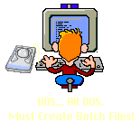
Enhance Your PROGRAMMING SKILLS
Akshay Saini (Campus Geek)
Powered by – geeksforgeeks.org
LEARN – SHARE - LEARN

Slide 2
What is a programmer?
No, it’s
WHO IS A PROGRAMMER?

Slide 3

Can I also be a Programmer

Slide 4

r, am I already a Programmer?

Slide 5

WTH!!! is a Programmer??

Slide 6

Yeah It’s YOU
Everyone is a Programmer.

Slide 7
Computer PROGRAMmer
System
Application
Drivers
Compilers
OS
Games
Office
Browser

Slide 8
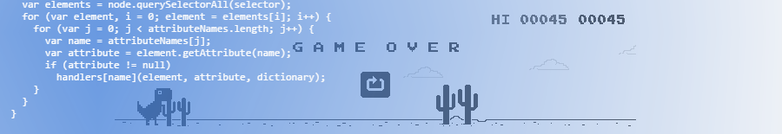
Start RELATEEing things
(argv and terminal)

Slide 9
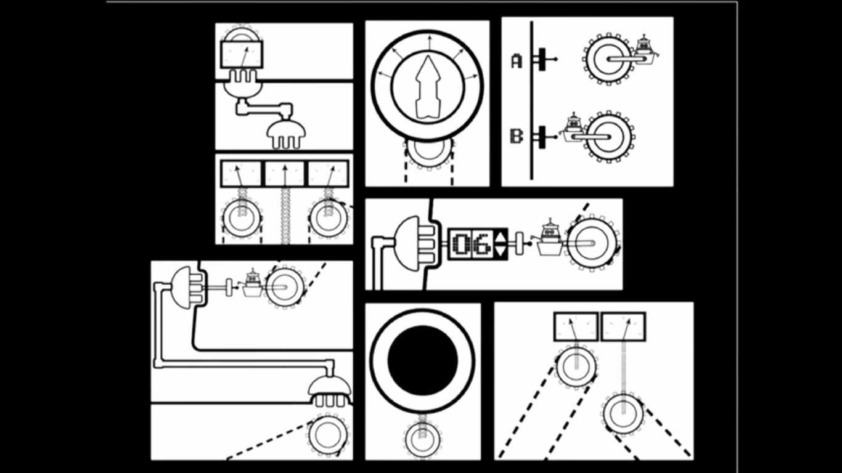

Slide 10
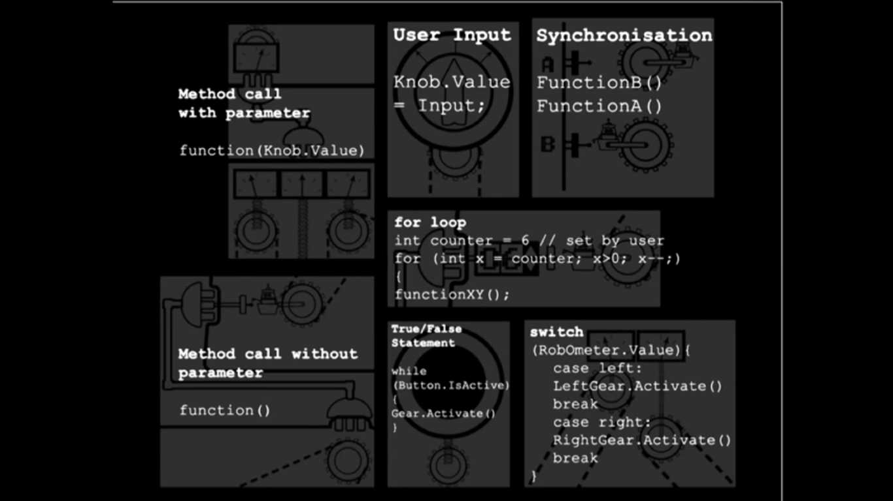

Slide 11


N’ven Can Hack!!
I’ll teach You.
Architect

Slide 12


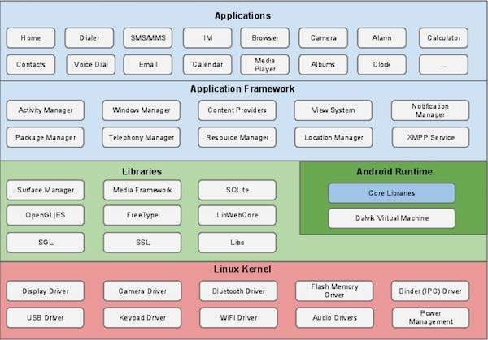

Android - Architecture

Slide 13
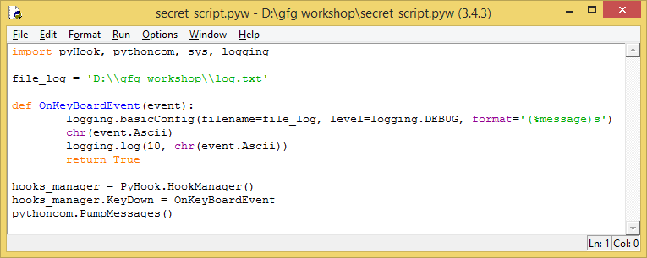
Key Logger in Python

Slide 14

Please guys "Hack To Learn, Don't Learn to Hack"

Slide 15
Hello World!!
AT THE END EVERYTHING
STARTS WITH
C
C++
#include <stdio.h>
int main(){
printf(“Hello World!!”);
return 0;
}
Using namespace std;
#include <iostream>
int main(){
cout << “Hello World!!” ;
return 0;
}

Slide 16
Hello World!!
JAVA
PYTHON
public class Hello{
public static void main(int argc, String argv[]){
System.out.println(“Hello World!!”);
}
}
print ‘Hello World!!’

Slide 17


Practice.geeksforgeeks.com
Practice.geeksforgeeks.com

Slide 18
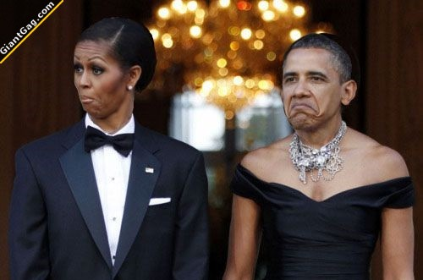
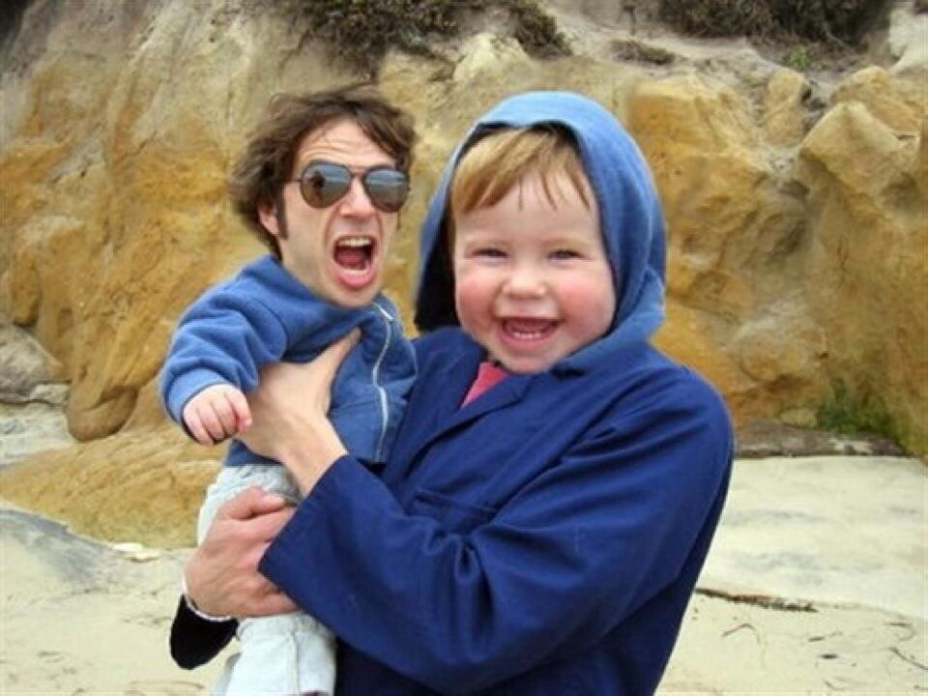
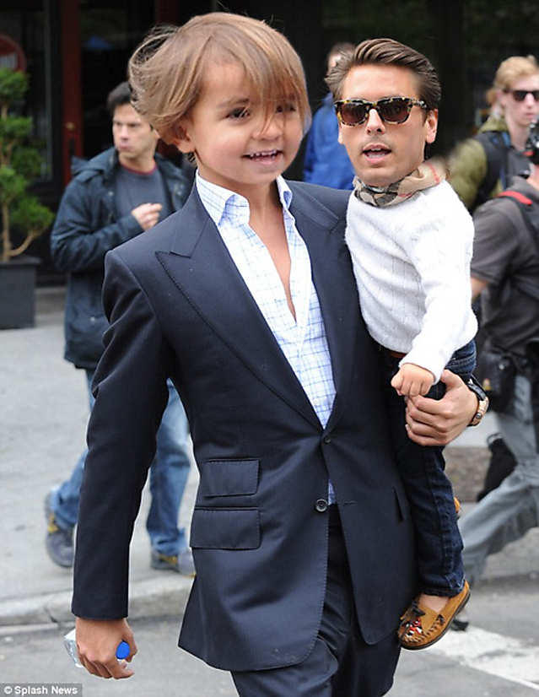
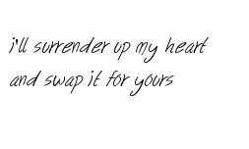


Slide 19

Functions(-_-)

Slide 20
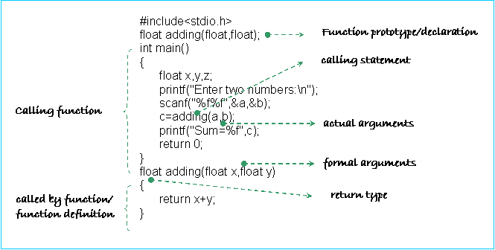

Slide 21
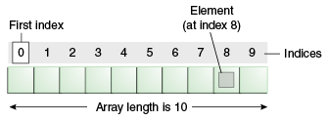
Arrays & Strings
(null)

Slide 22
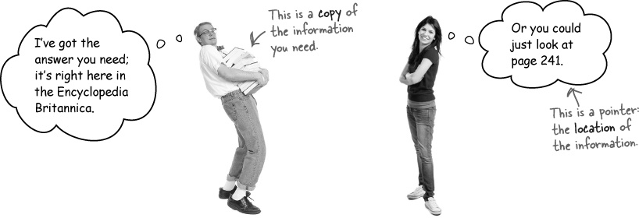
Pointers
*

Slide 23
int * Pointer_Function(int * trap){ //do stuff you want to return &trap; }

Slide 24
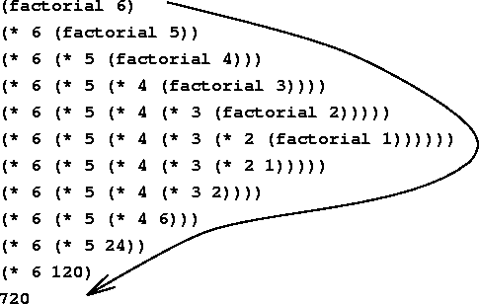
Recursion

Slide 25



Semicolon
#include <stdio.h>
void main(int n, int f){
if (scanf("%d", &n)){
if (f = 1){
while (n != 1){
if (f = n * f)
if (n--)
{}
}
if(printf("Factorial is %d\n", f))
{}
}
}
}

Slide 26

Create your own Header Files
Libraries
Macros
Use

Slide 27

Code Optimization, Efficiency & Prime Number!!
[for(i=3; i--;)]

Slide 28
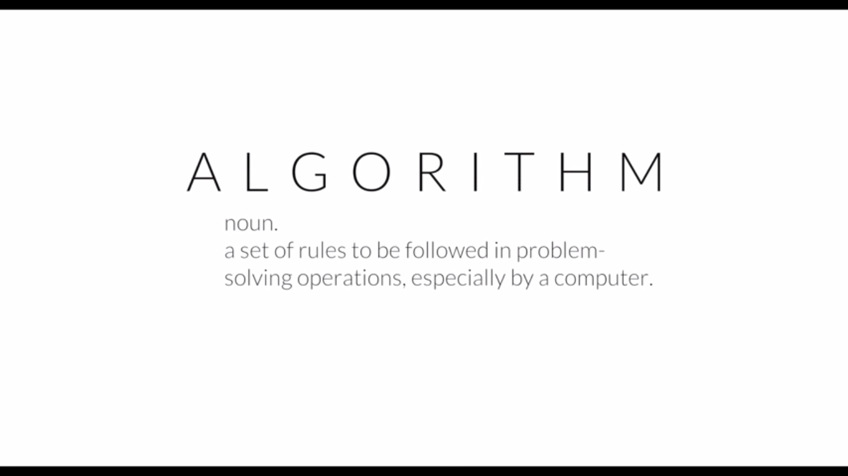

Slide 29
List of Must Algorithms
Min, Max, BFS-DFS
Binary Search
Sorting Techniques
Stack and Queue
Hashing
Divide and Conquer
Greedy algorithm
Backtracking
Dynamic Programming
Floyd or Warshall's algorithm
Kruskal's or Prim's algorithm
Dijkstra's algorithm

Slide 30
Programming Myths……
Programming is boring.
That C++ is good or Language X is better than the rest.
Once you master a language, you’re done learning.
I Am Woman. I Can’t Code.
Programming is a field for loners.
I Must Be A Genius (With An IQ OF 160).
I Have To Go To University To Learn To Code.
I Have To Master Mathematics To Learn Programming Languages.
Great programmers write the fastest code
That computer science is all about programming.
That all programmers work in the IT department.
That Java and JavaScript are the same. You won't believe the number of times someone has come up to me and said "I want to learn Java to learn JQuery

Slide 31
DO’s & Don’ts
{LEARN – SHARE – LEARN}
( PLEASE NOTE DOWN,
Your mind is like PRIMARY MEMORY don’t work as SECONDARY )
Get out of your comfort zone and challenge yourself.
Learn something -> build something with it -> repeat.
Don't fool yourself into believing you can learn by reading alone. Reading is helpful, but you must practice everything you read.
Learn about the hardware.
Focus on Building the simplest projects you can think of.
Stop being in such a rush. Slow down, ENJOY THE JOURNEY.

Slide 32
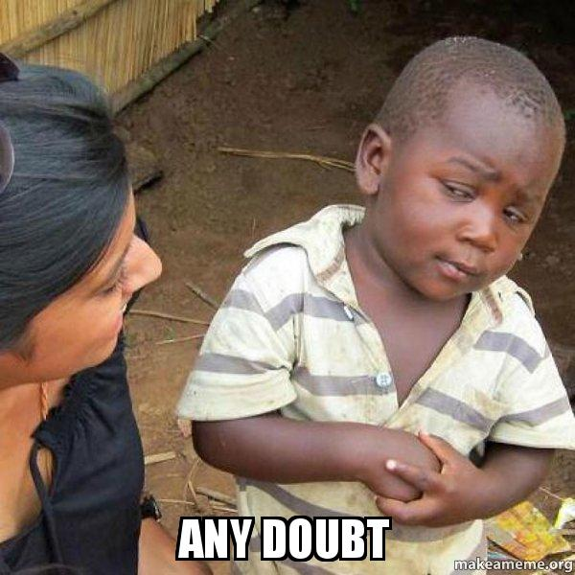

Code…Sleep…Code…Sleep…Code…

Slide 33

LEARN - SHARE - LEARN
Thank You!!!
Keep Programming ;)

